Slide 1
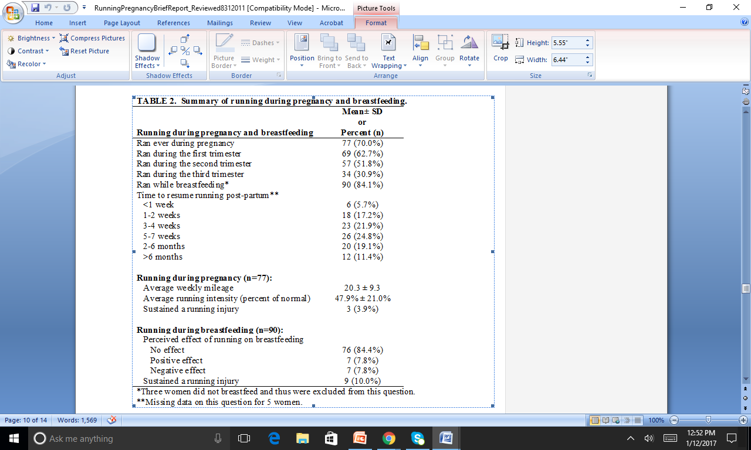
The majority of runners ran during pregnancy (70.0%, 77/110), with 62.7% running during the first trimester, 51.8% during the second trimester, and fewer than one third (30.9%) during the third trimester (Table 2). From the 77 women who ran during pregnancy, we observed the average weekly mileage during pregnancy for those who ran to be 20.3 ± 9.3 miles. Average running intensity was reported to be 47.9% ± 21.0% as a percent of non-pregnant running effort. A small number (3.9%, 3/77) reported sustaining a running injury while pregnant. About a quarter (24.8%) waited 5-7 weeks to resume running post-partum. A small fraction (5.7%) resumed running less than a week after giving birth. Some women (11.4%) waited more than six months post-partum to resume running.

